Slide 1

Problems on Convolution 2017

Slide 2
Reference
Data
Youtube
Code

Slide 3

[2017]

Slide 5


Slide 7
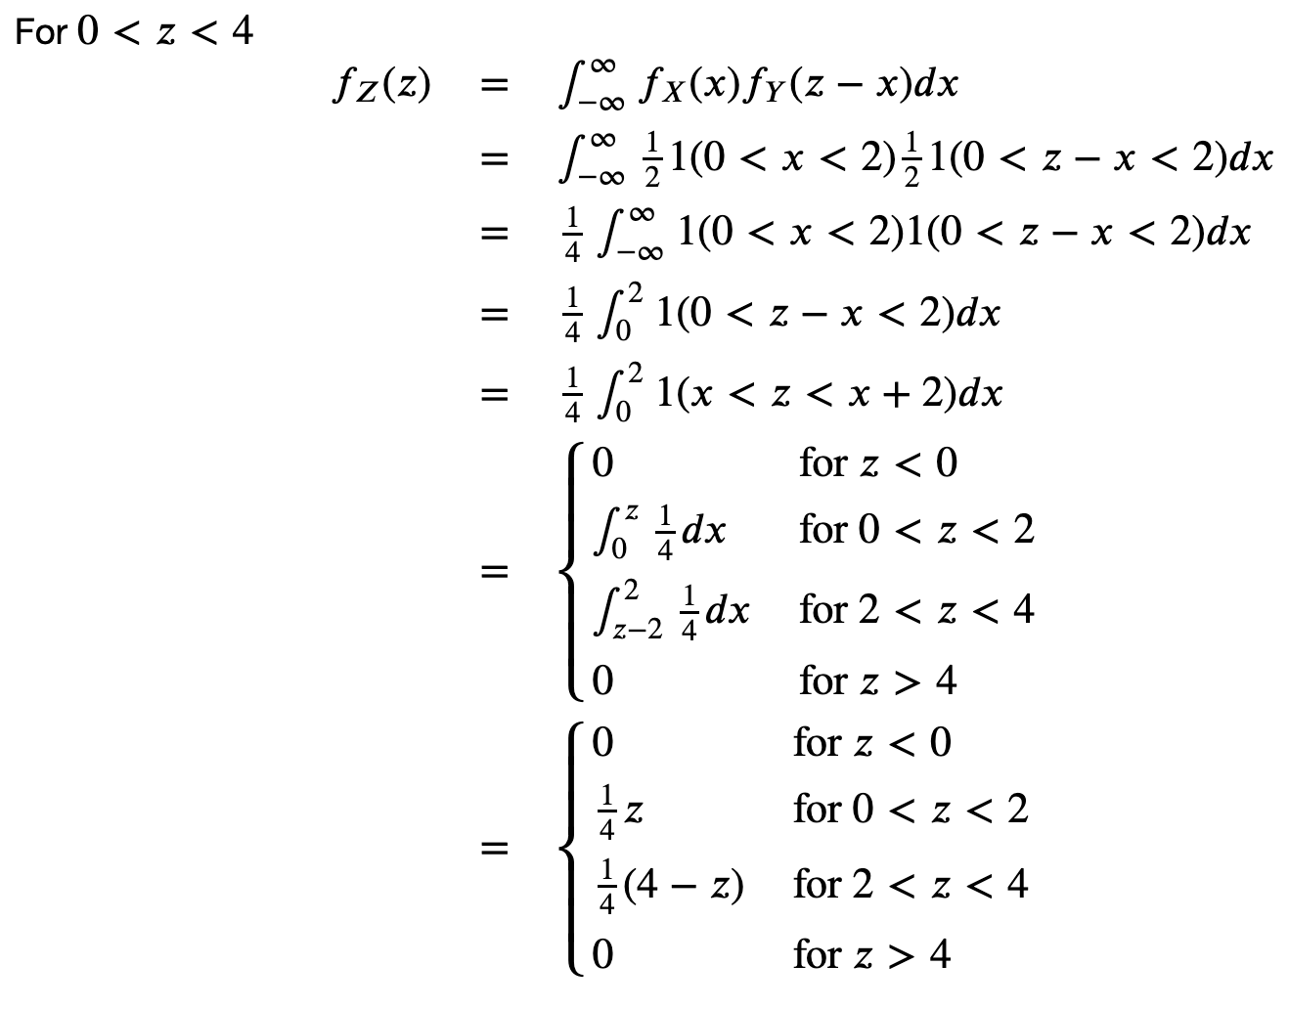

Slide 8


Slide 9


Slide 10


Slide 11


